Slide 1

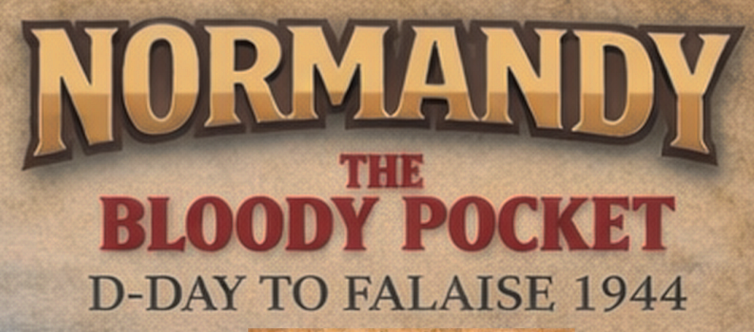
PLAYER AID
Launch Offensive (cost = 1 action)
See Counter Attacks
unmodified roll of 1 is always unsuccessful
unmodified roll of 6 is always successful
ACTIONS
COUNTER ATTACKS
Defense Strength is Army Battle Value + terrain
Attack Strength is Attack DRMs (Pz Units, Nebel, Kampf, Model)
If Roll + Attack Strength > Defense Strength – advance Ger Units
Cost 1 supply point per Panzer Unit/Kampgruppe
If any Pz Units/Kampgruppen -> victory is +1 to Hitler Approval
Defeat – 1 loss to Pz units, Nebelwerfers eliminated
unmodified roll of 1 is always unsuccessful
unmodified roll of 6 is always successful
Deploy Reinforcements
Each reinforcement must make Transport Check
Successful – move to Strategic Reserve Box
Unsuccessful – move to In Transit Box
Units in In Transit Box make 1 Transport Check per turn; successful roll allows move to Strategic Reserve or map
Must pass Hitler Roll to deploy to map from either box
Can deploy from Strategic Reserve to map (cost = 1 action)
Can move directly from In Transit to Map (cost = 1 action)
Kampfgruppen move directly to map or Strategic Reseve box, no rolls needed (cost = 1 action)
RESOURCE ROLLS / CHECKS
To increase resource pay 1 action
If roll > current value increase by 1
For resource checks must roll <= current value
No DRMs on cards for Resource Checks
+1 DRM on Transport and Supply if weather is overcast
No Resource Check on Supply points, these are just spent on attacks
SIEGES
Redeploy Panzer Unit to Strategic Reserve Box (cost = 1 action)
Must pass Transport Roll
Units in Strategic Reserve can
- Remain
- Refit ((cost = 1 action)
- Deploy to map (cost = 1 action)
(requires Hitler roll)
If Attack Value > 6 less than defense value in Fortress – Declare Siege
See Siege Table
Place siege marker on space
ALLIED ARMY MOVEMENT
US 3rd Army activates when 1st Army advances to Avranches
Defense Value = terrain + DRMs
Attack Value = DRMs
If die roll + Attack Value > Defense Value – advance army
If less than defense, defender, takes 1 loss (no advance
If equal to defense, defender takes 2 losses (no advance)
If greater than defense, defender takes 2 losses (advance) and if defense contains pz units, Hitler Approval down 1
4. Refit Reduced Panzer Unit (cost = 1 action)
Must be in Strategic Reserve Box
Cannot refit Kampfgruppen or rebuild eliminated units
Reduced Panzer Units are flipped to Full Strength (+1 to +2)
US 3rd ARMY DISPERSAL
5. Attempt to Increate a Resource Level on the Resource tracks (cost = 1 action per track)
Roll > current resource level to increase resource level
All DRMs on cards are for Resource Attempts NOT Resource Checks.
May disperse -> reduce 3rd Army strength by 1 for each Britanny fortress (Brest, Lorient) bypassed (min. 2 strength)
Card #47 drawn before 3rd Army reaches Britanny, must disperse
SUPPLIES
6. Fortify Town (cost = 3 actions)
Place “Fortress” marker on Town space
Defense Value 4 for rest of game
All Fortress rules apply, e.g., Siege rules
If Supply Level reaches 0, minus 1 to all Defense Values for player
Attacks cost 1 Supply Point per Panzer Unit (divisions, Kampfgruppen, 101st Tiger Battalion all count)
HITLER APPROVAL
7. Put Action(s) into Strategic Reserve Box
Max. 2 Actions in Reserve Box
Can be used in future turns
Required to
Redeploy a panzer unit from map to Strategic Reserve box
Deploy Panzer Unit from In Transit or Strategic Reserve to map
Avoid having to carry out “Hitler Interventions” as defined by several Event Cards
“Hitler Intervention” cards: the player must fail the check for the intervention to go ahead
D-DAY LANDINGS
Cards #1 and #2 always first two cards
Roll one die for each army
Brit/Can armies succeed if roll > 1
US 1st Army succeed if roll > 2
If success put army into its beach box
If fail, leave in start box
Always succeed on turn 2
VICTORY/DEFEAT
Any Allied Army reaches space 0 (Falaise Gap) -> LOSE
Hitler Approval reaches -2 -> LOSE
End of 1st Deck or card #25-> if S Caen and Avranches are both Allied controlled
No cards left and Falaise Gap German controlled -> WIN

